Slide 1
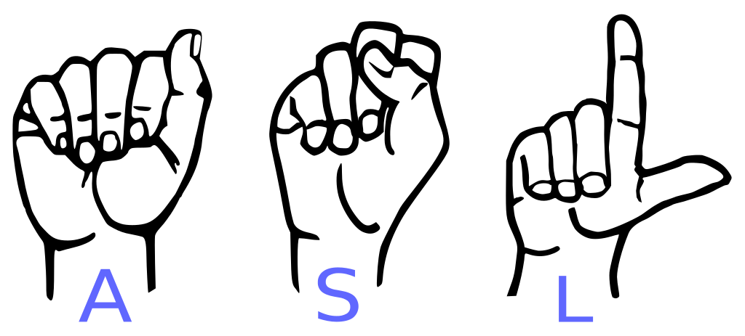
Translating ASL Using Object Detection
Kyle Lindstrom

Slide 2

Kyle Lindstrom
Github
LinkedIn

Slide 3
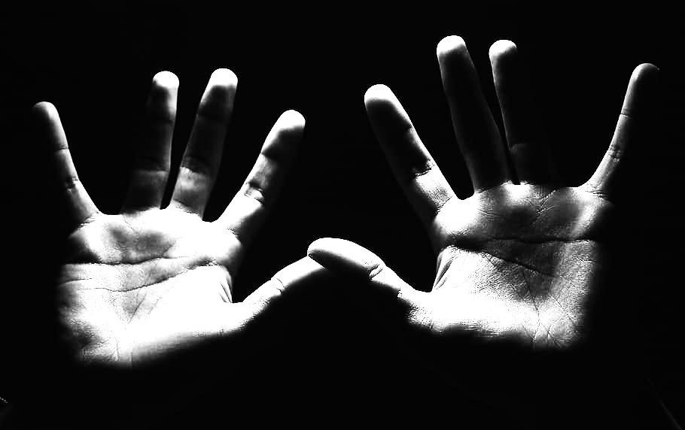
Agenda
Business Problem
Data Overview
Modeling
Conclusions
Advanced projects

Slide 4
Understanding the Problem
The Problem
The Stakeholder
Item 2
Item 3
The Solution
Around 1 million ASL users in the United States
Over 99% of the population can’t understand
Google translate wants to incorporate sign language
They’d like to identify live action video phrases
Develop a neural network capable of the required predictions
Identify and track still hand signals as well as complex motions

Slide 5

Key Performance Indicator
Accuracy
What percentage of the model’s predictions are correct?

Slide 6
The Data

Slide 7
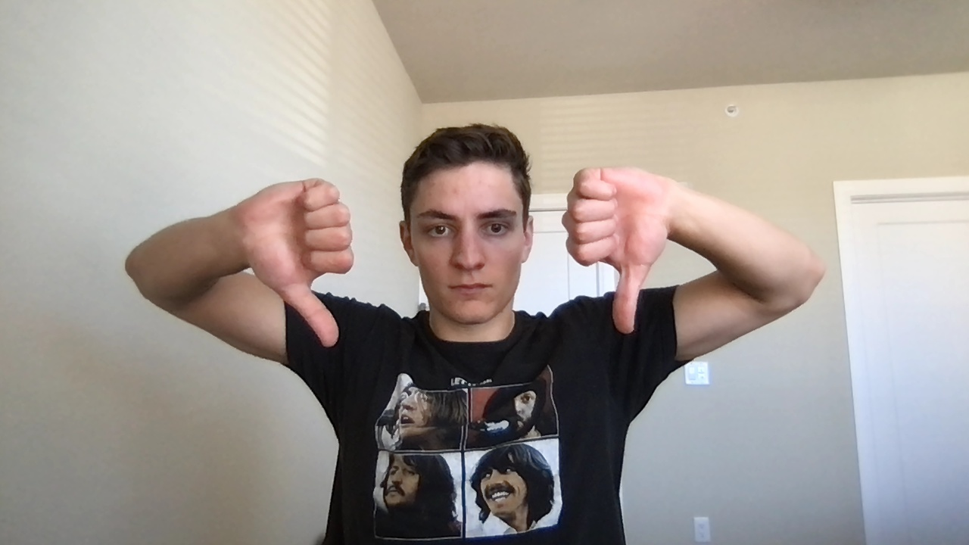
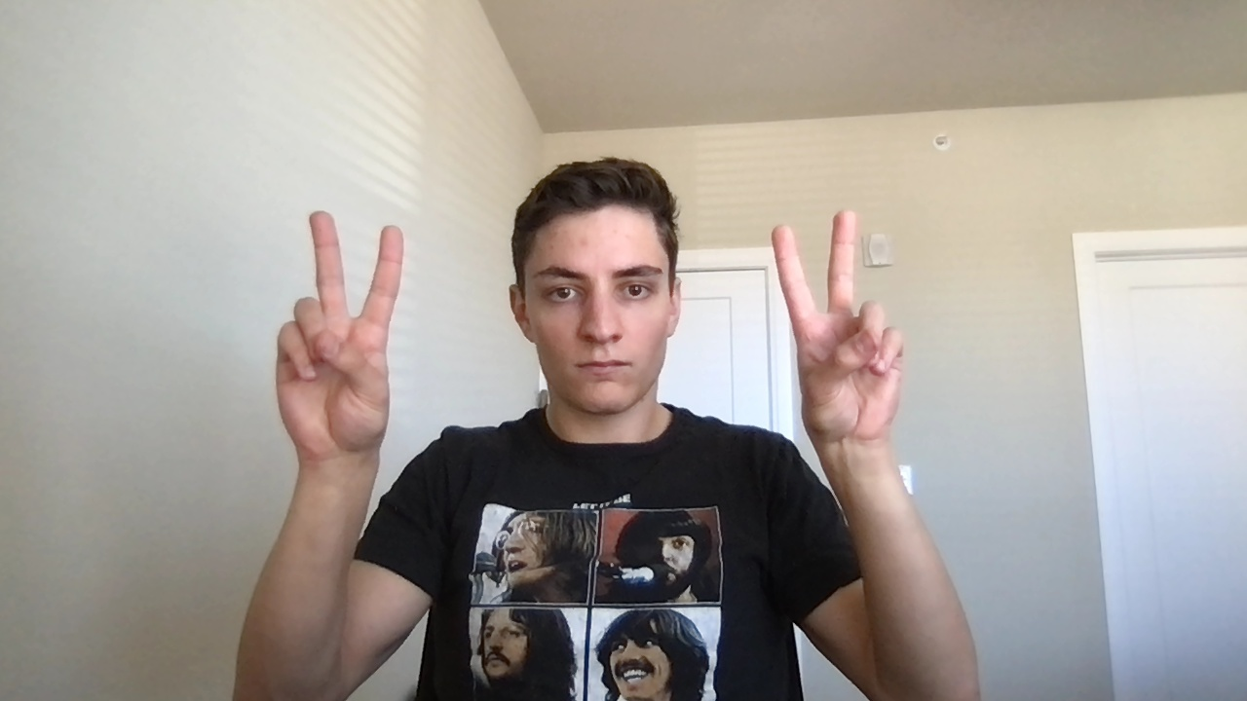
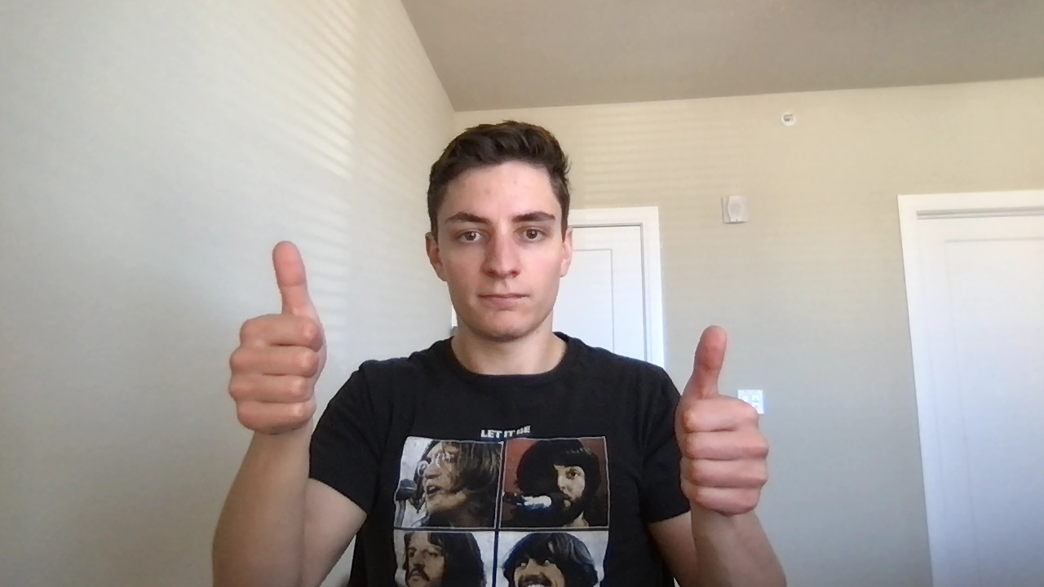
Procedure
Collect many images of the gestures and symbols to be translated
Annotate the data accurately using LabelImg and MediaPipe
Split into training, validation, and test sets

Slide 8
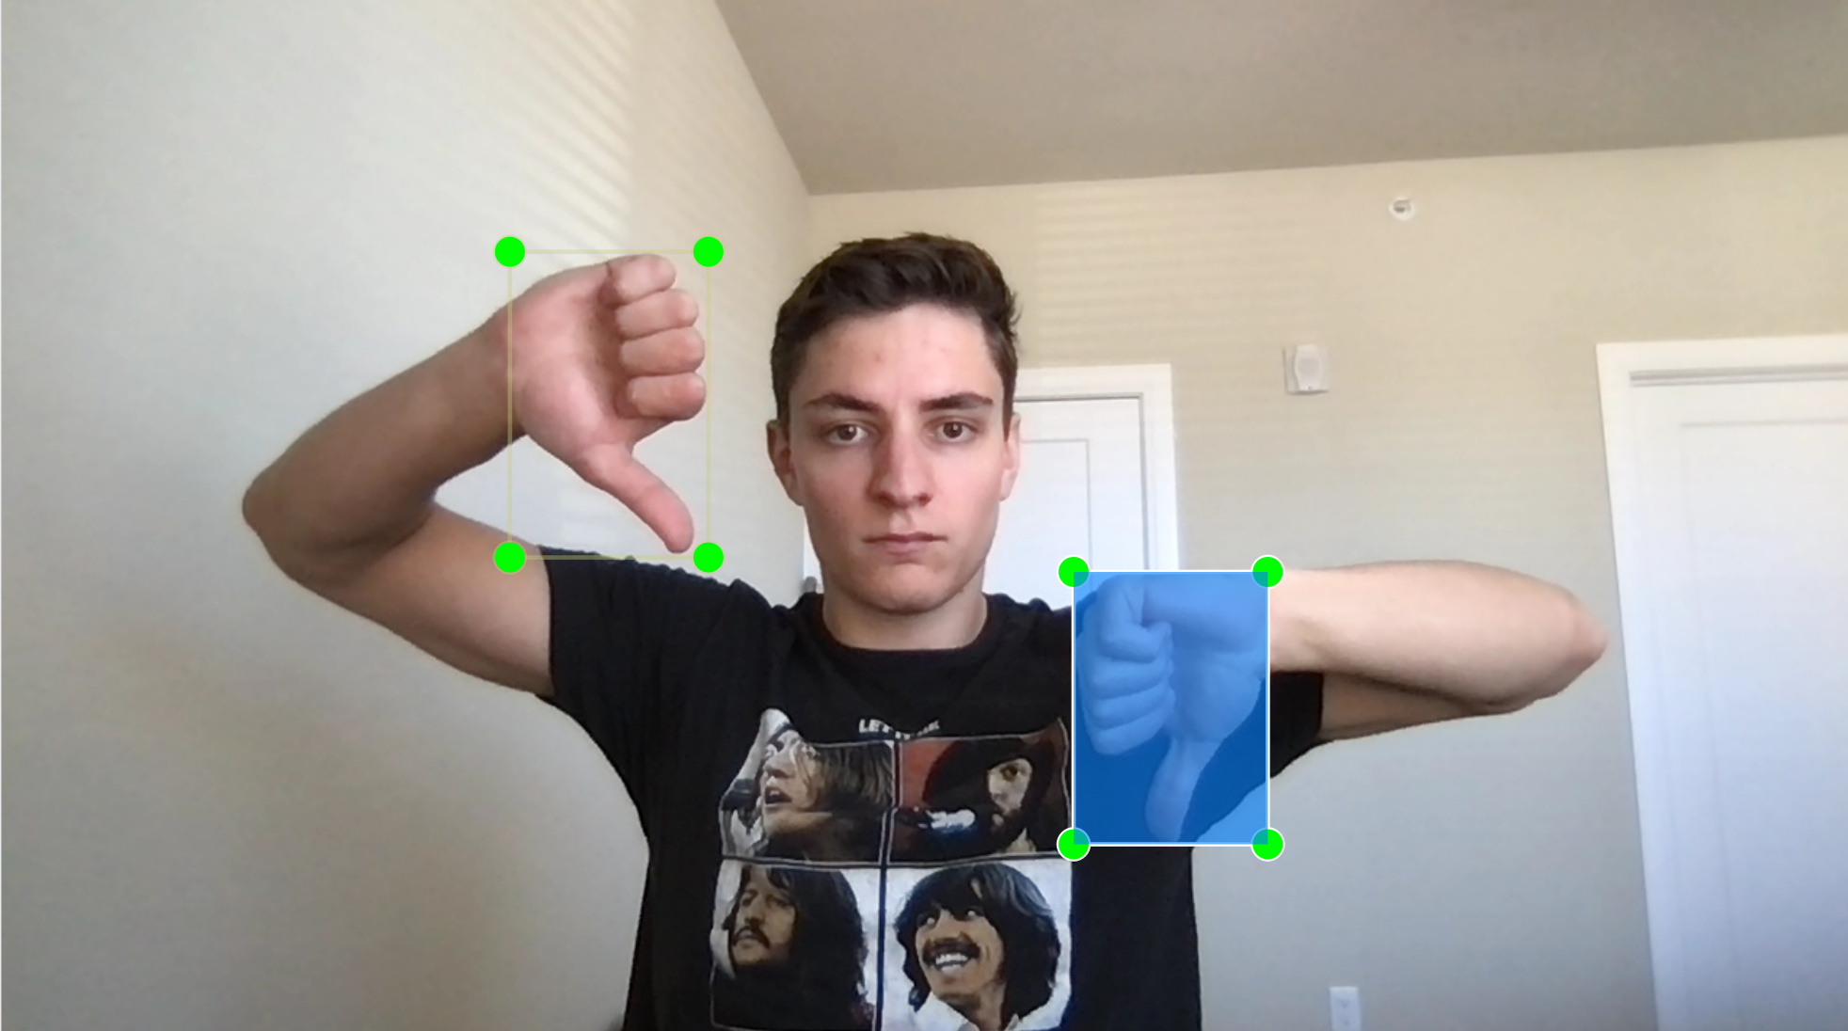
Single Frame Hand Signals
Collected using OpenCV
Annotated using LabelImg

Slide 9
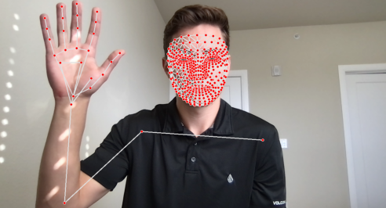
Complex Gestures
Collected using OpenCV
Annotated using MediaPipe

Slide 10

Limitations
Only pictures of me
Same lighting/background
Single person in image

Slide 11
Final Dataset
Still Images
120 total examples split into 3 categories:
Thumbs Up, Thumbs Down, Peace
Action Gestures
240 total examples split into 4 categories:
Hello, Nice To Meet You, Thanks, Goodbye

Slide 12
Results

Slide 13
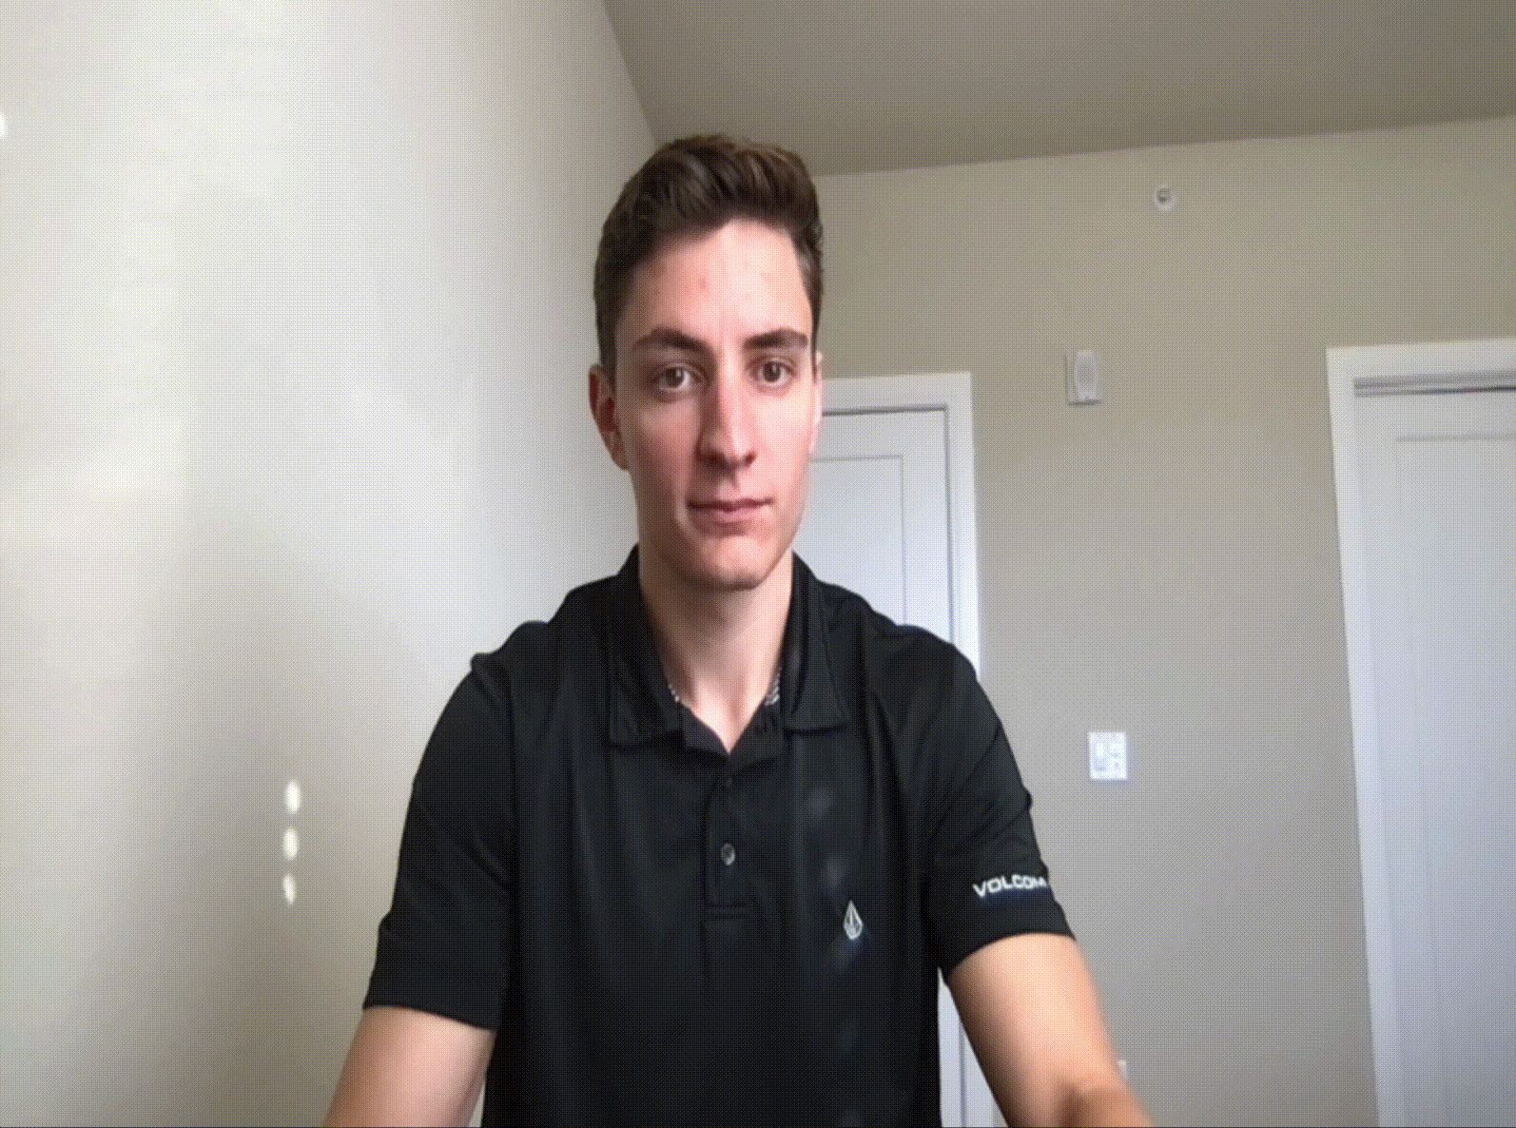
Hand Signals
Model Architecture:
SSD MobileNet V2 FPNLite
Testing Accuracy (24 Test Instances):
100%

Slide 14
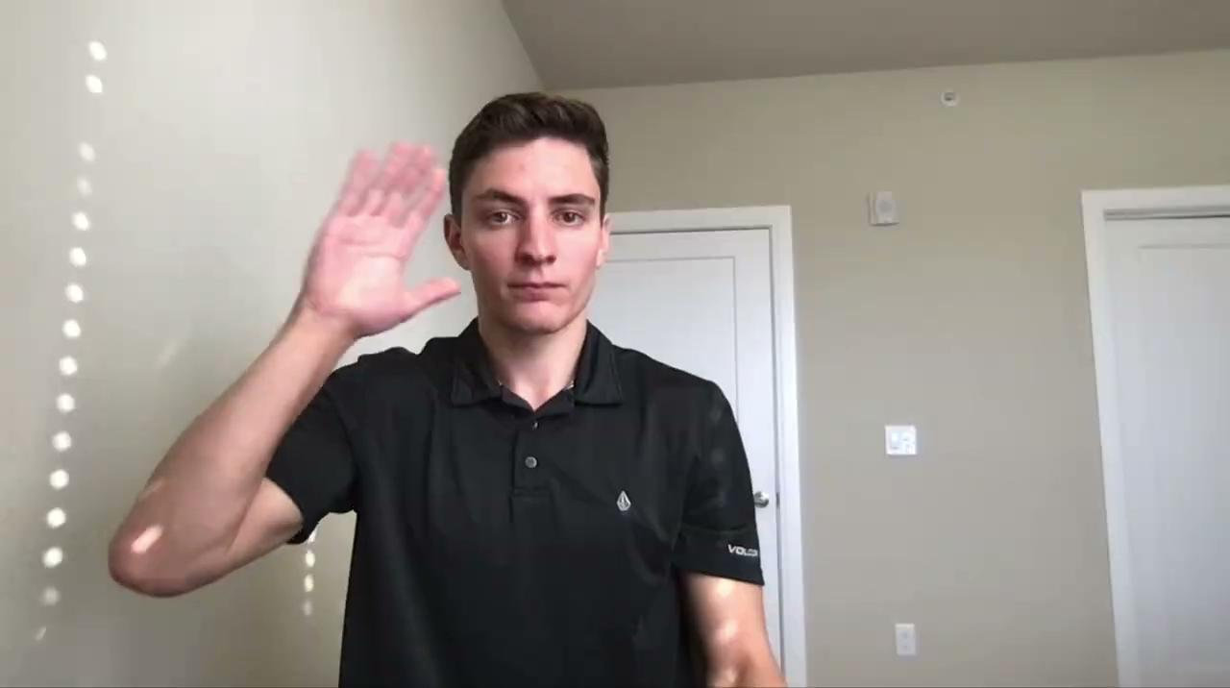
Action Gestures
Model Architecture:
Sequential with LSTM and Dense Layers
Testing Accuracy (24 Test Instances):
100%

Slide 15

Future Insights
More variety in training data
Add a full suite of ASL gestures
Explore possibility of combining models

Slide 16
Thank You!
Kyle Lindstrom
Github
LinkedIn

